Slide 1
Low Fidelity Prototype Presentation
By Haley, Jackson, and Munshi
Group 3

Slide 2
Norman’s 7 Principles

Slide 3
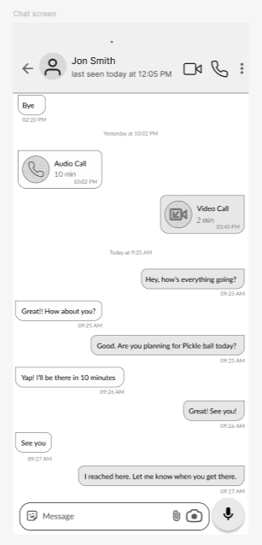
Use knowledge in the world and knowledge in the head
Knowledge in the world
  Calling and text features grouped together
  Clear indicators of who is reaching out when
  Easy to follow and understand format
Knowledge in the head
  Behaves in a similar way to other messenger platforms so that the user understands how to interact with our app based on their previous experience

Slide 4
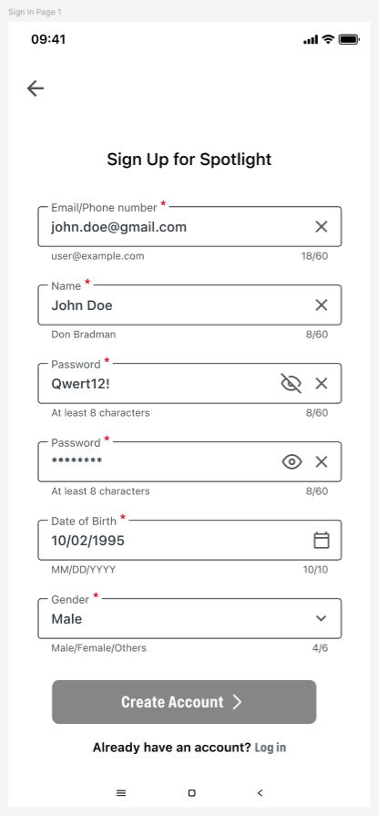
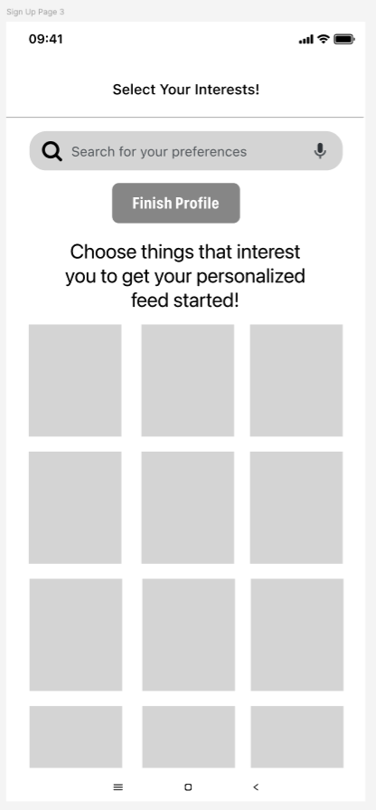
Simplify task structures
To create an account on our platform is a simple two step process.
It guides the user step by step on what they need to do.
It provides helpful guidance like a calendar drop down to make questions that much easier to understand and answer

Slide 5
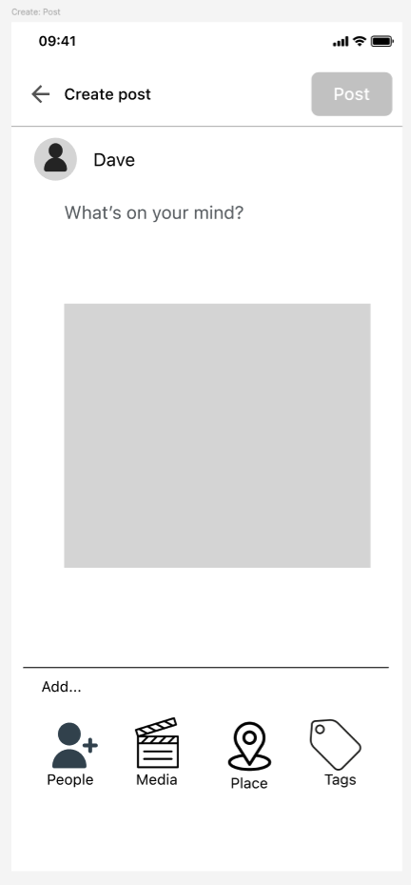
Make things visible
Our post creation makes it very clear what options you have available to you.
Every option is clearly labeled so it is easy to use and intuitive

Slide 6
Get the mapping right
Our chat function is very similar to what a user is used to using, so it matches their mental model.
It’s clear what their options are so they are able to know what to do.
Their intentions here are to communicate with their friends and we have tried to make that as easy as possible for them.

Slide 7
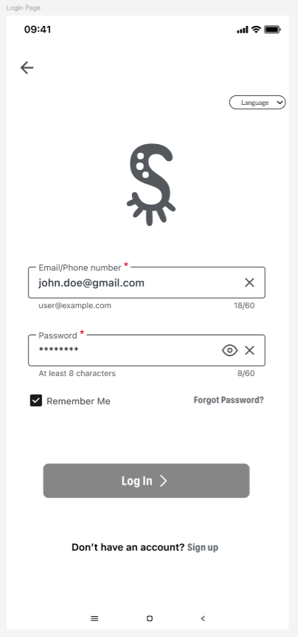
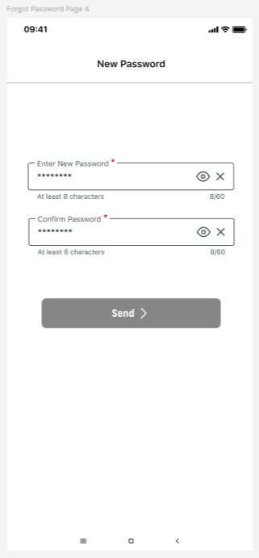
Convert constraints into advantages
Reduce user choices so only the correct one remains.
Users are only able to provide email or password in the login screen
Setting up new password during forgot password

Slide 8
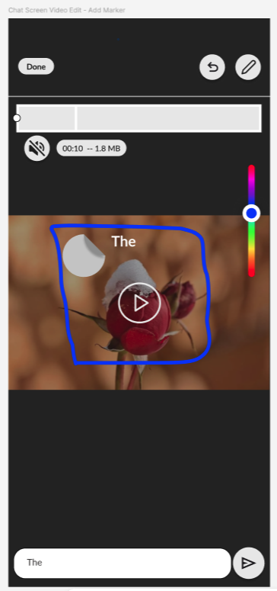
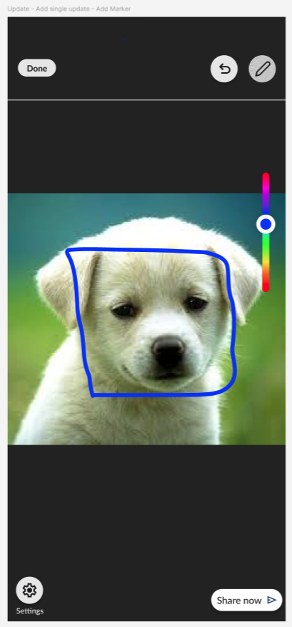
Design for error
Designs must allow recovery, undo, or confirmation
Undo ‘Add Marker’ while modifying picture or video for updates and sending it to others

Slide 9
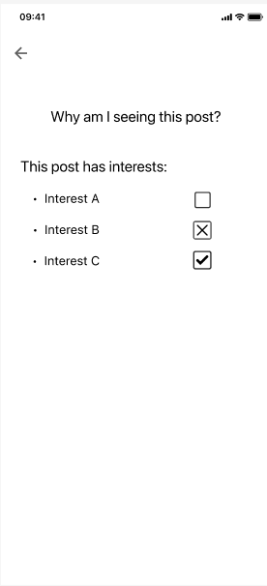
When all else fails - Standardize
This feature is something new in our design, so it is not as intuitive as our other designs.
So, we have done our best to make it easy for the user to find and learn to use.
This feature is easy to find in the three dots in the top corner of a post, where you would usually find more information and interactions.
In addition, we have made its design standard to the rest of our app.

Slide 10
Shneiderman’s 8 Golden Rules

Slide 11
Golden Rules of Interface Design
These principles are meant to make an interface consistent, inclusive, and predictable so that users can interact confidently

Slide 12
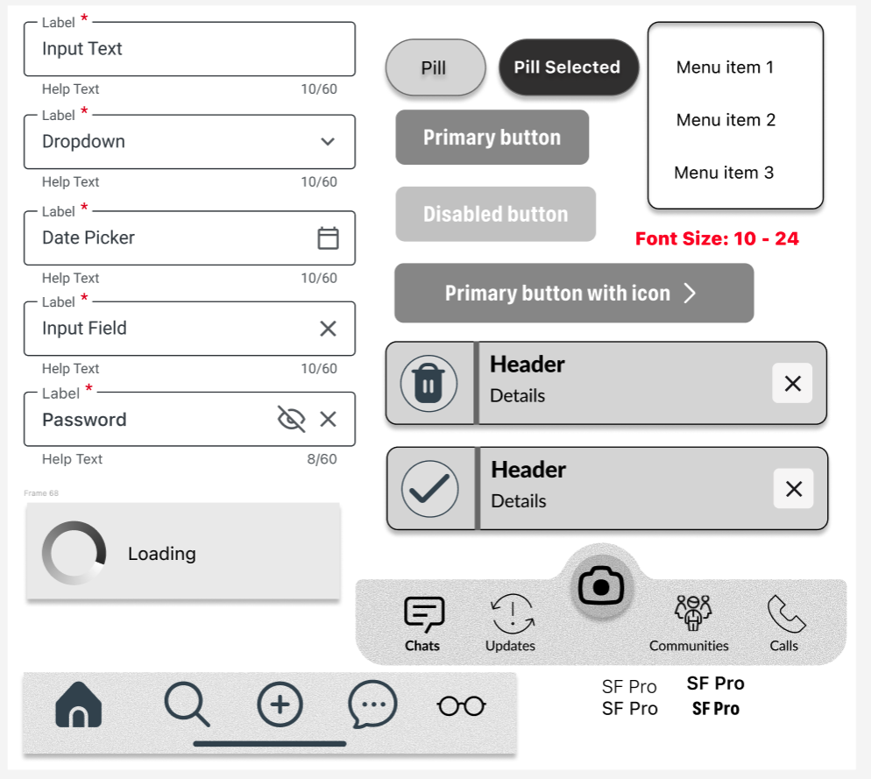
Strive for consistency
Pills
Input boxes
Menu
Buttons
Loading
All follow the same structure and sequence in both the Spotlight feed and the Messenger module.
Toast
Spotlight Bottom Navbar
Messenger Bottom Navbar

Slide 13
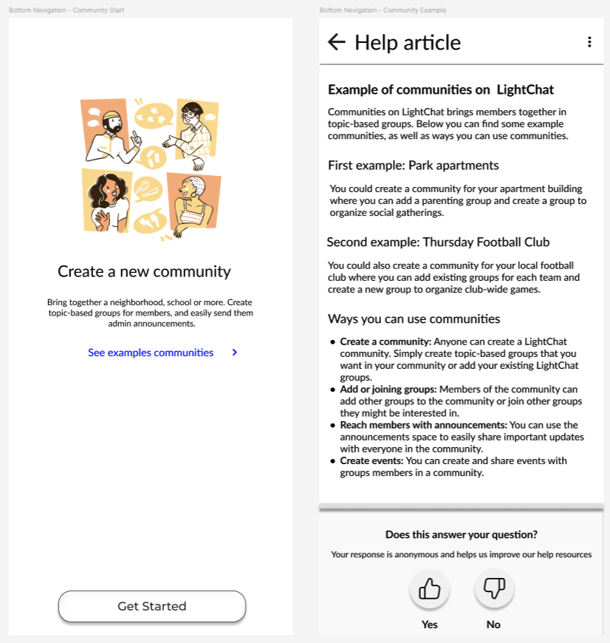
Cater to universal usability
We considered both new and experienced users.
Tooltips guide beginners, while the overall layout feels familiar to users who already use other social platforms.
Community helps users of different backgrounds find relevant spaces, supporting inclusive design.
Help tooltip for beginners

Slide 14
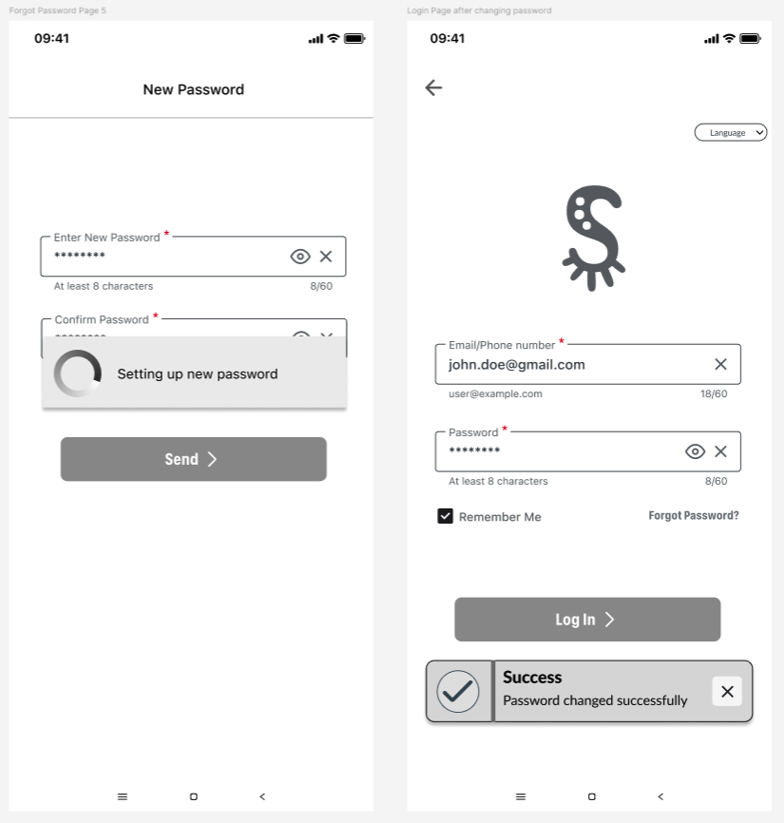
Offer informative feedback
For every user action, our system provides immediate feedback.
User gets loading spinner after clicking “Submit.”
Immediate, proportional feedback

Slide 15
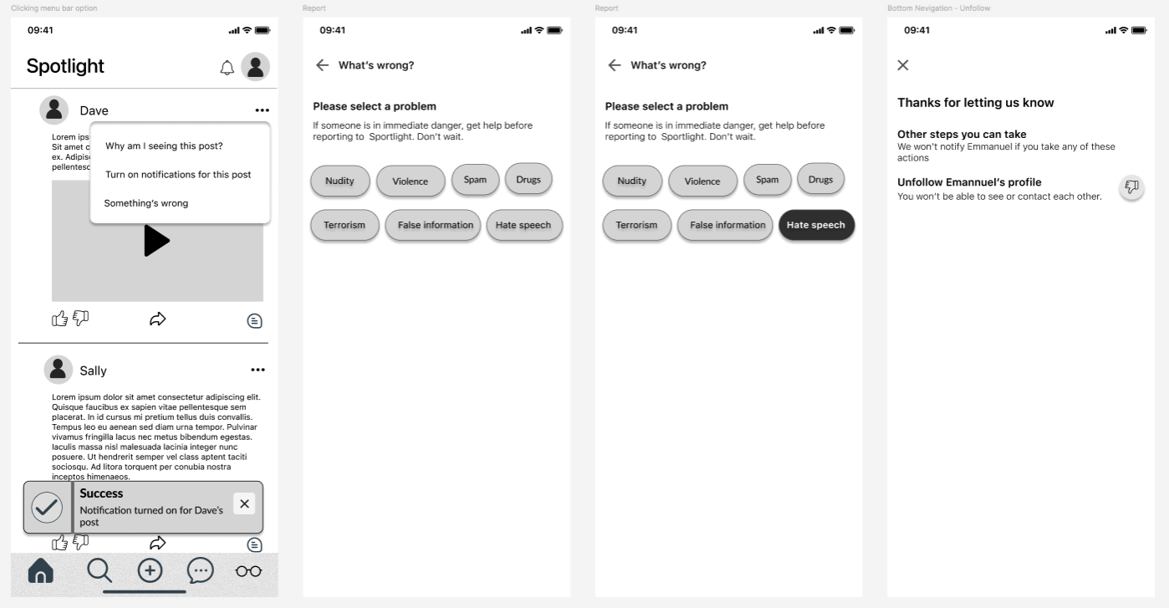
Design dialogues to yield closure
Organized interactions to have clear beginnings and ends.
Report a post closure gives users satisfaction and readiness for their next step

Slide 16
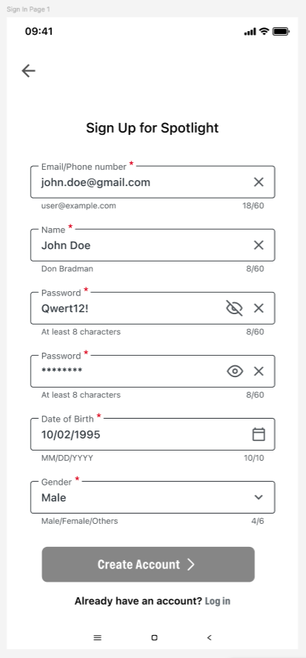
Prevent errors
Prevent and handle errors through clear messaging.
If a user enters an invalid email during sign-up, a helper text explains what went wrong and how to fix it.
Help text could be used as a reasoning

Slide 17
Prevent errors
Give the user a chance to undo actions like adding a marker before posting.
Undo ‘Add Marker’ while modifying picture or video for updates and sending it to others

Slide 18
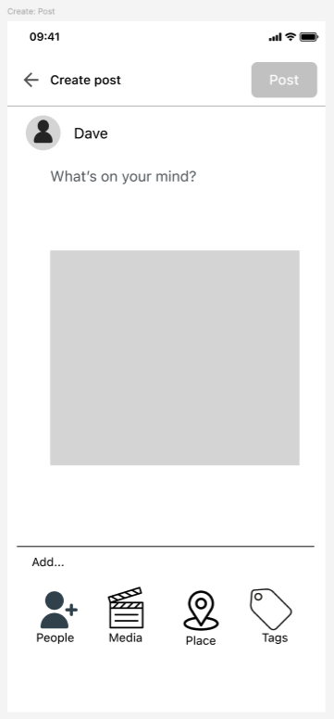
Permit easy reversal of actions
Allowing reversibility reduces anxiety and encourages users to explore features freely.
  Undo and Cancel options appear wherever possible.
Undo an ‘Added Marker’
Cancel or discard a post

Slide 19
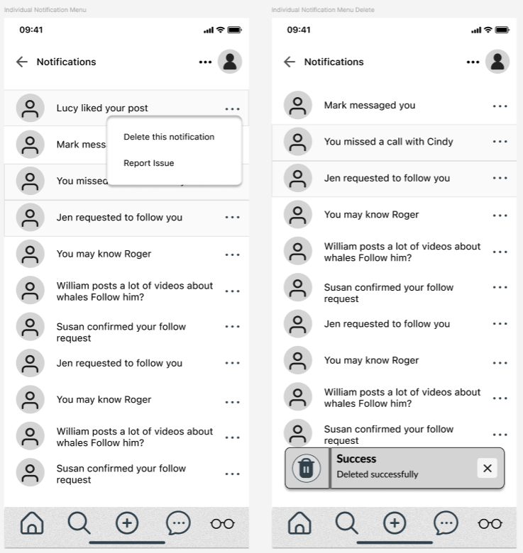
Support internal locus of control
Our system always lets the user take the lead.
This maintains a sense of control and trust
User initiates to delete a notification, system simply responds

Slide 20
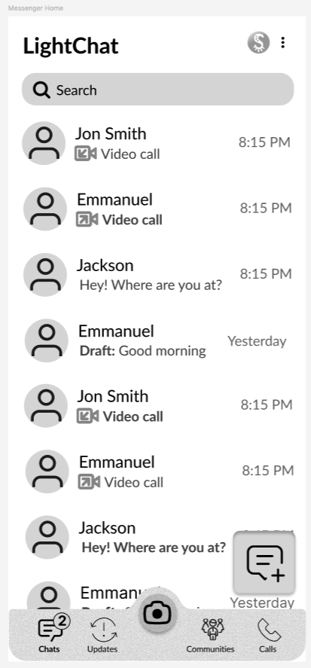
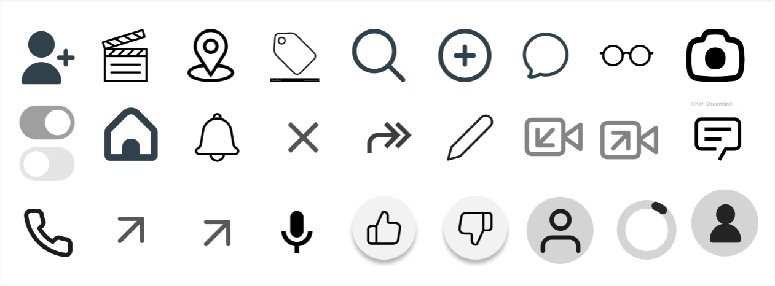
Reduce short-term memory load
Designed for recognition rather than recall
  Common icons such as home, search, and create are based on real-life metaphors, so users can understand their meaning instantly.
  This keeps interaction intuitive and reduces cognitive load.
Real life metaphors
Effective use

Slide 21
Summary of the Golden Rules
Our design choices follow Shneiderman’s Golden Rules by keeping interactions consistent, inclusive, and forgiving.
Together, these principles make Spotlight easy to learn, efficient to use, and pleasant to explore.

Slide 22
Principles to Support Usability

Slide 23
Golden Rules of Interface Design
These principles were introduced by Shneiderman and Dix, and they focus on what makes a system easy to learn, flexible to use, and reliable over time.
They are grouped into three categories: Learnability, Flexibility, and Robustness.
Each of these describes how well a system helps users accomplish their goals efficiently and confidently.

Slide 24
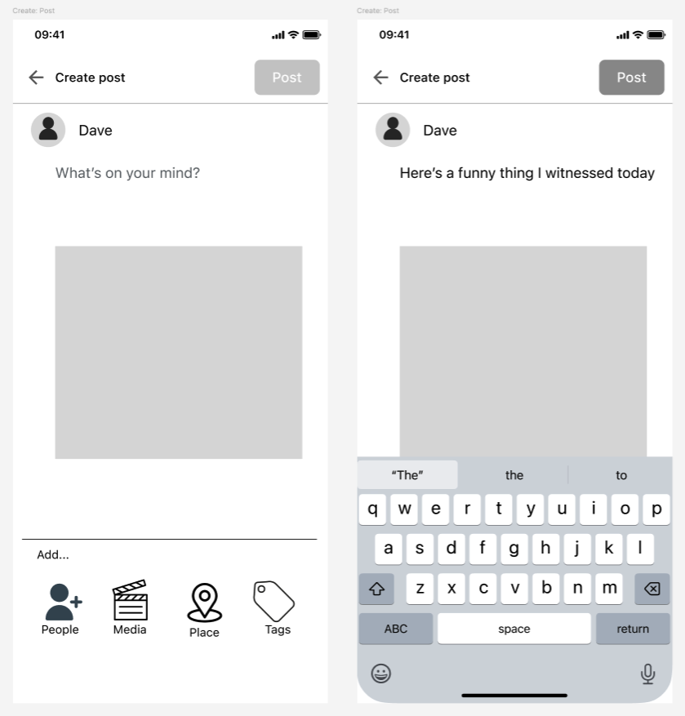
Learnability :Operation Visibility
Predictability
How easily a new user can understand and start using the system effectively.
  For example, when users click buttons or menus, they always behave in expected ways.
  That predictability reduces the mental effort needed to guess what will happen next.
Anticipating available options

Slide 25
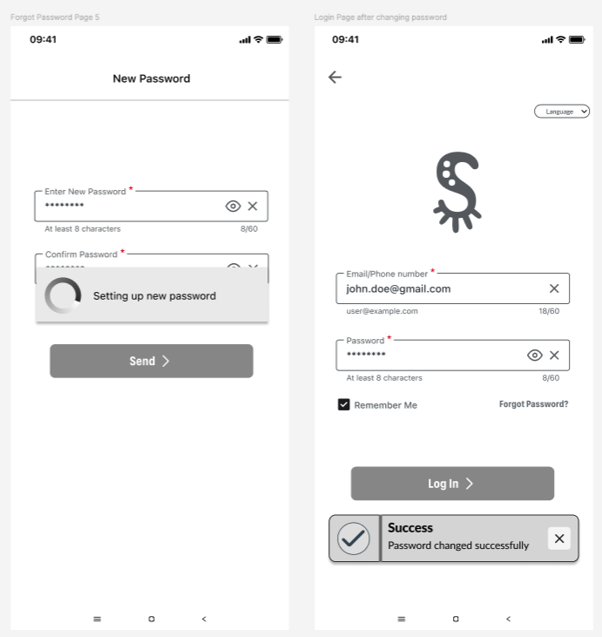
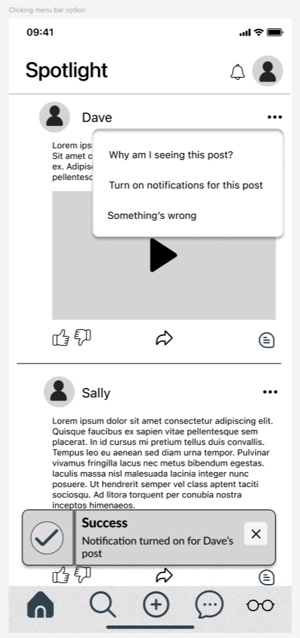
Learnability: Eventual vs Immediate Honesty
Users are logging in to verify the password change
Turning on notification for a specific user

Slide 26
Learnability: Familiarity
Affordances and metaphors make it easier for new users to understand what they can do just by looking at the interface.

Slide 27
Learnability: Familiarity
Affordance
We rely on real-world metaphors, like the camera, telephone icon or a post that looks pressable, so users can apply their existing knowledge.
Object’s appearance suggests how to use it
Looks presable

Slide 28

Learnability: Familiarity
Metaphor/Guessability
Presenting a digital feature as a known
physical concept.
Looks presable

Slide 29
Learnability: Consistency
Ensured consistency across all screens, so once users learn one part of the system, they can easily transfer that knowledge elsewhere.
Altogether, these learnability principles make our design simple, discoverable, and welcoming to new users

Slide 30
Flexibility
Describes how users and systems can interact in multiple ways

Slide 31
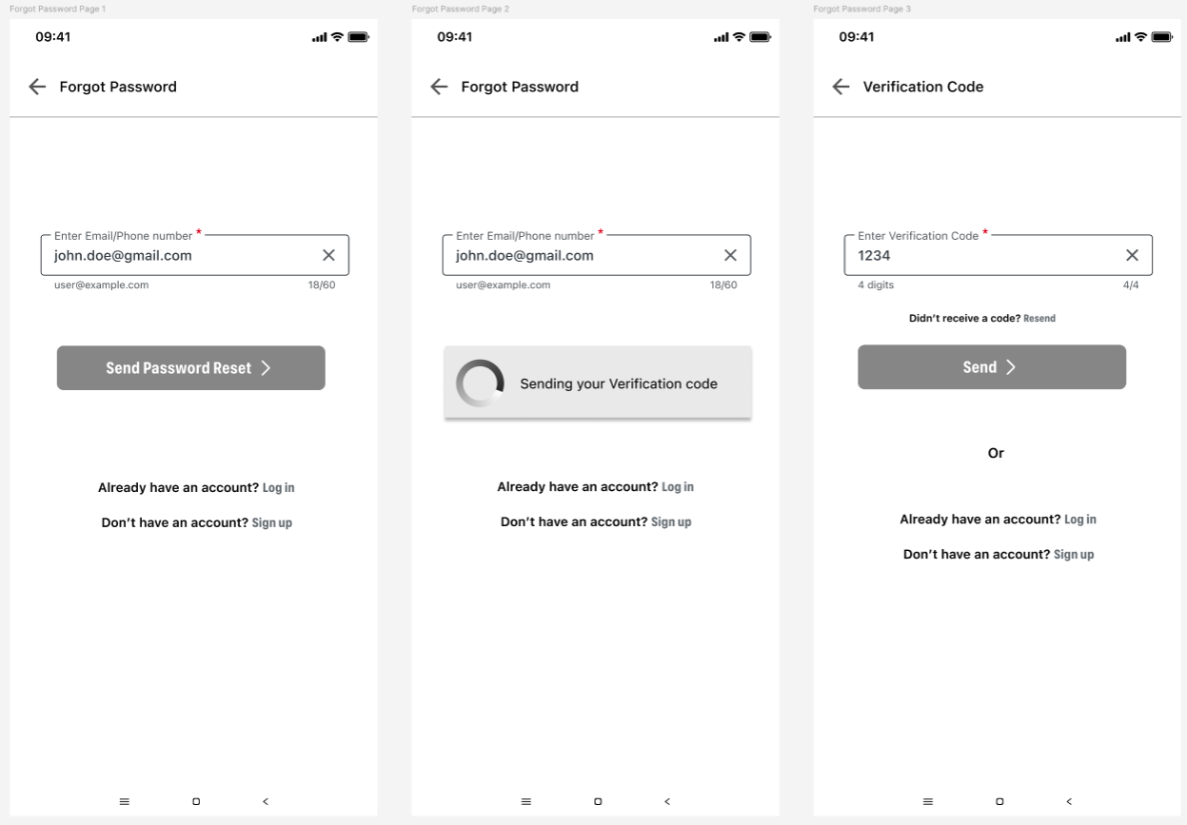
Flexibility: User Preemptive Dialog
It is the communication taking place between the user and the system.
User initiates for password reset; system responds with a verification code first.

Slide 32
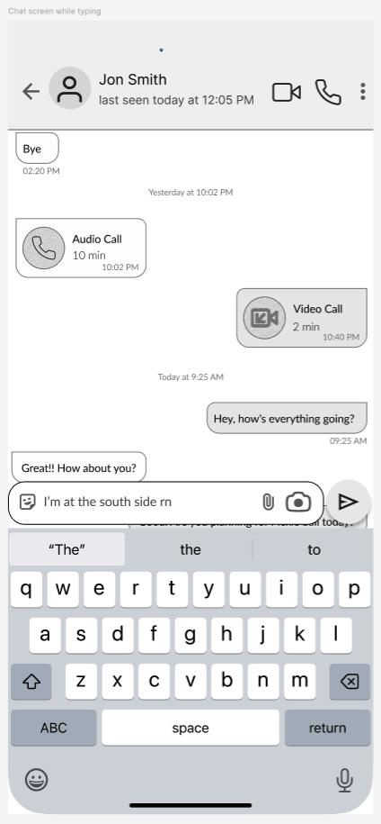
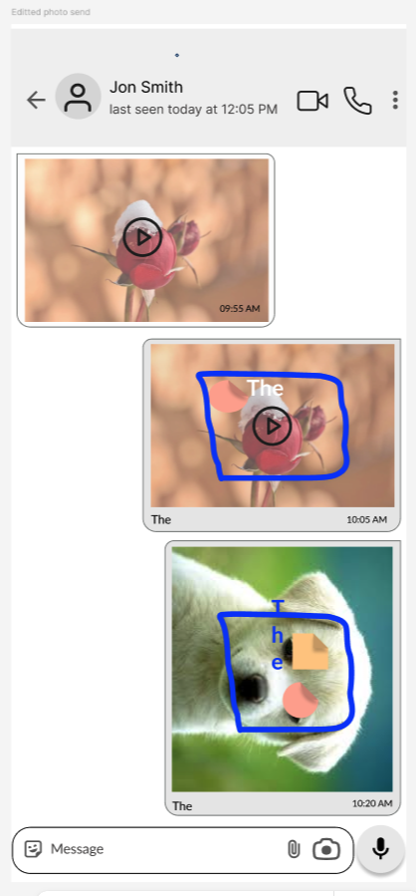
Flexibility: Concurrent Multi-threading
Typing or photo/video editing while listening to music.
Users can perform different tasks at the same time, such as editing a post while music plays in the background.
This allows multitasking without losing focus on the main activity.

Slide 33
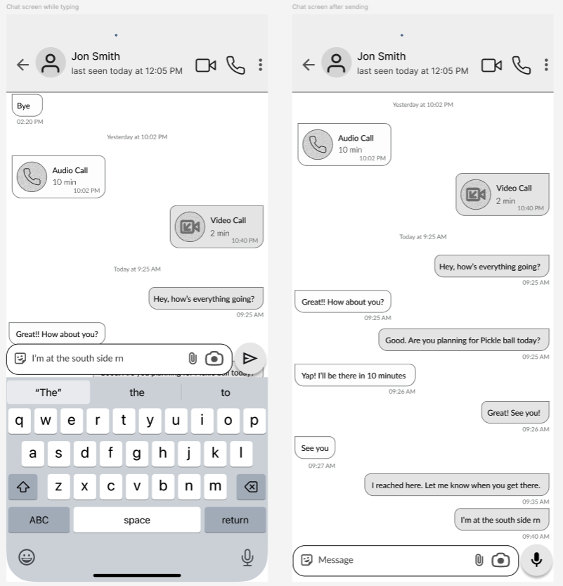
Flexibility: Task migratability
User sends message → System receives it →Sends it back to another user
user←→system
Transfer of control of a task efficiently and smoothly between user ←→system

Slide 34
Robustness
Focuses on how reliably a system helps users achieve their goals and recover from errors

Slide 35
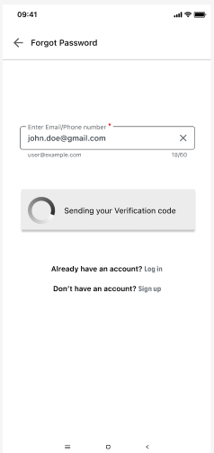
Robustness: Observability
Degree of support provided to the user for determining and achieving goals successfully.
Here is an example of browsability. You can see what the system is doing and when it finishes its task as it is clearly displayed for the user to see.

Slide 36
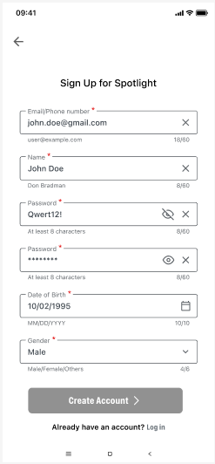
Robustness: Recoverability
Here is an example of forward error recovery. Each input field has specifications in order to tell the user as the system encounters an error with the input. The user is able to directly alter the input according to the prompt in order to fix the error.

Slide 37
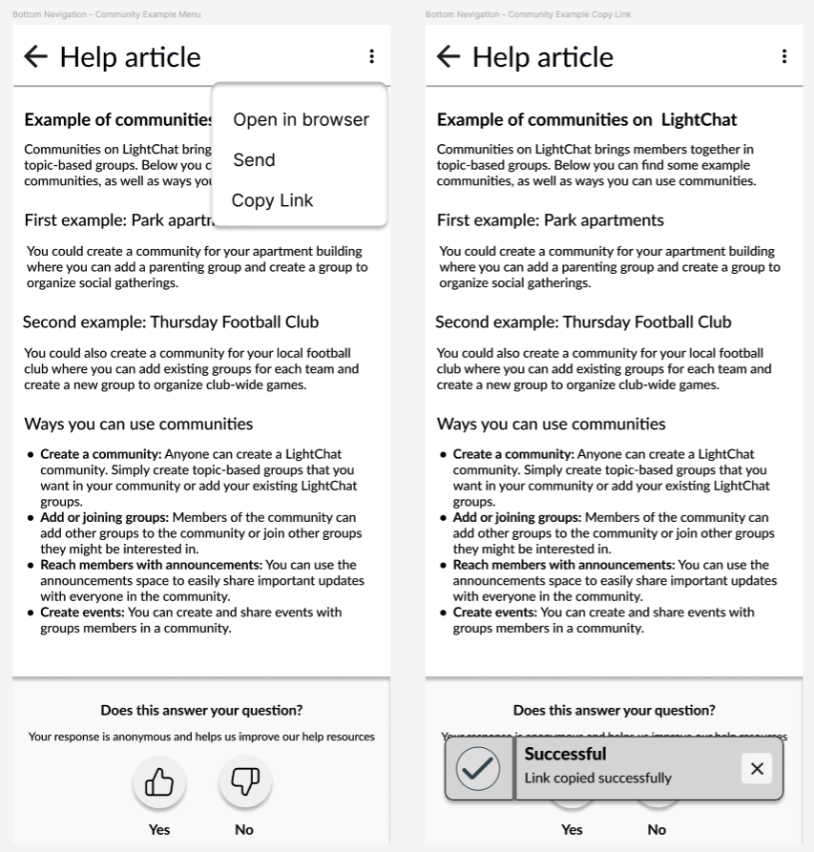
Robustness: Responsiveness
Here is an example of instantaneous response. When you copy the link to the help article, you immediately get a pop up that says you have successfully copied the link. This quickly lets the user know their action was successful.

Slide 38
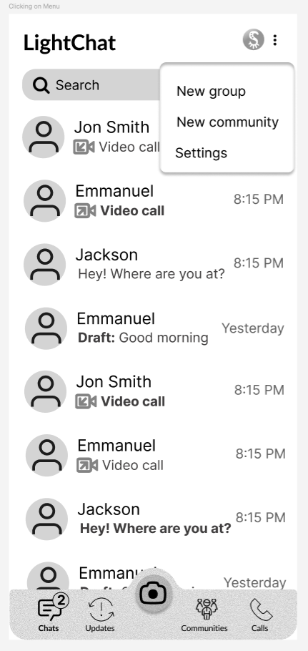
Robustness: Task Conformance
Here is an example of task completeness in our LightChat feature. The app provides a ton of options for communicating with those that you care about. There is a large variety of user tasks that can be mapped by the services we offer.

Slide 39

Summary and Q&A
Norman’s 7 Principles
  Guided our focus on visibility, mapping, and error recovery.
  Ensured users understand system behavior through clear signifiers and feedback.
Shneiderman’s 8 Golden Rules
  Helped maintain consistency, usability, and control across the app.
  Reinforced immediate feedback, reversibility, and intuitive interactions.
Principles Supporting Usability
  Learnability: Predictable and familiar interface for first-time users.
  Flexibility: Multiple ways to interact and customize experiences.
  Robustness: Reliable performance, observability, and easy recovery.

